Slide 1
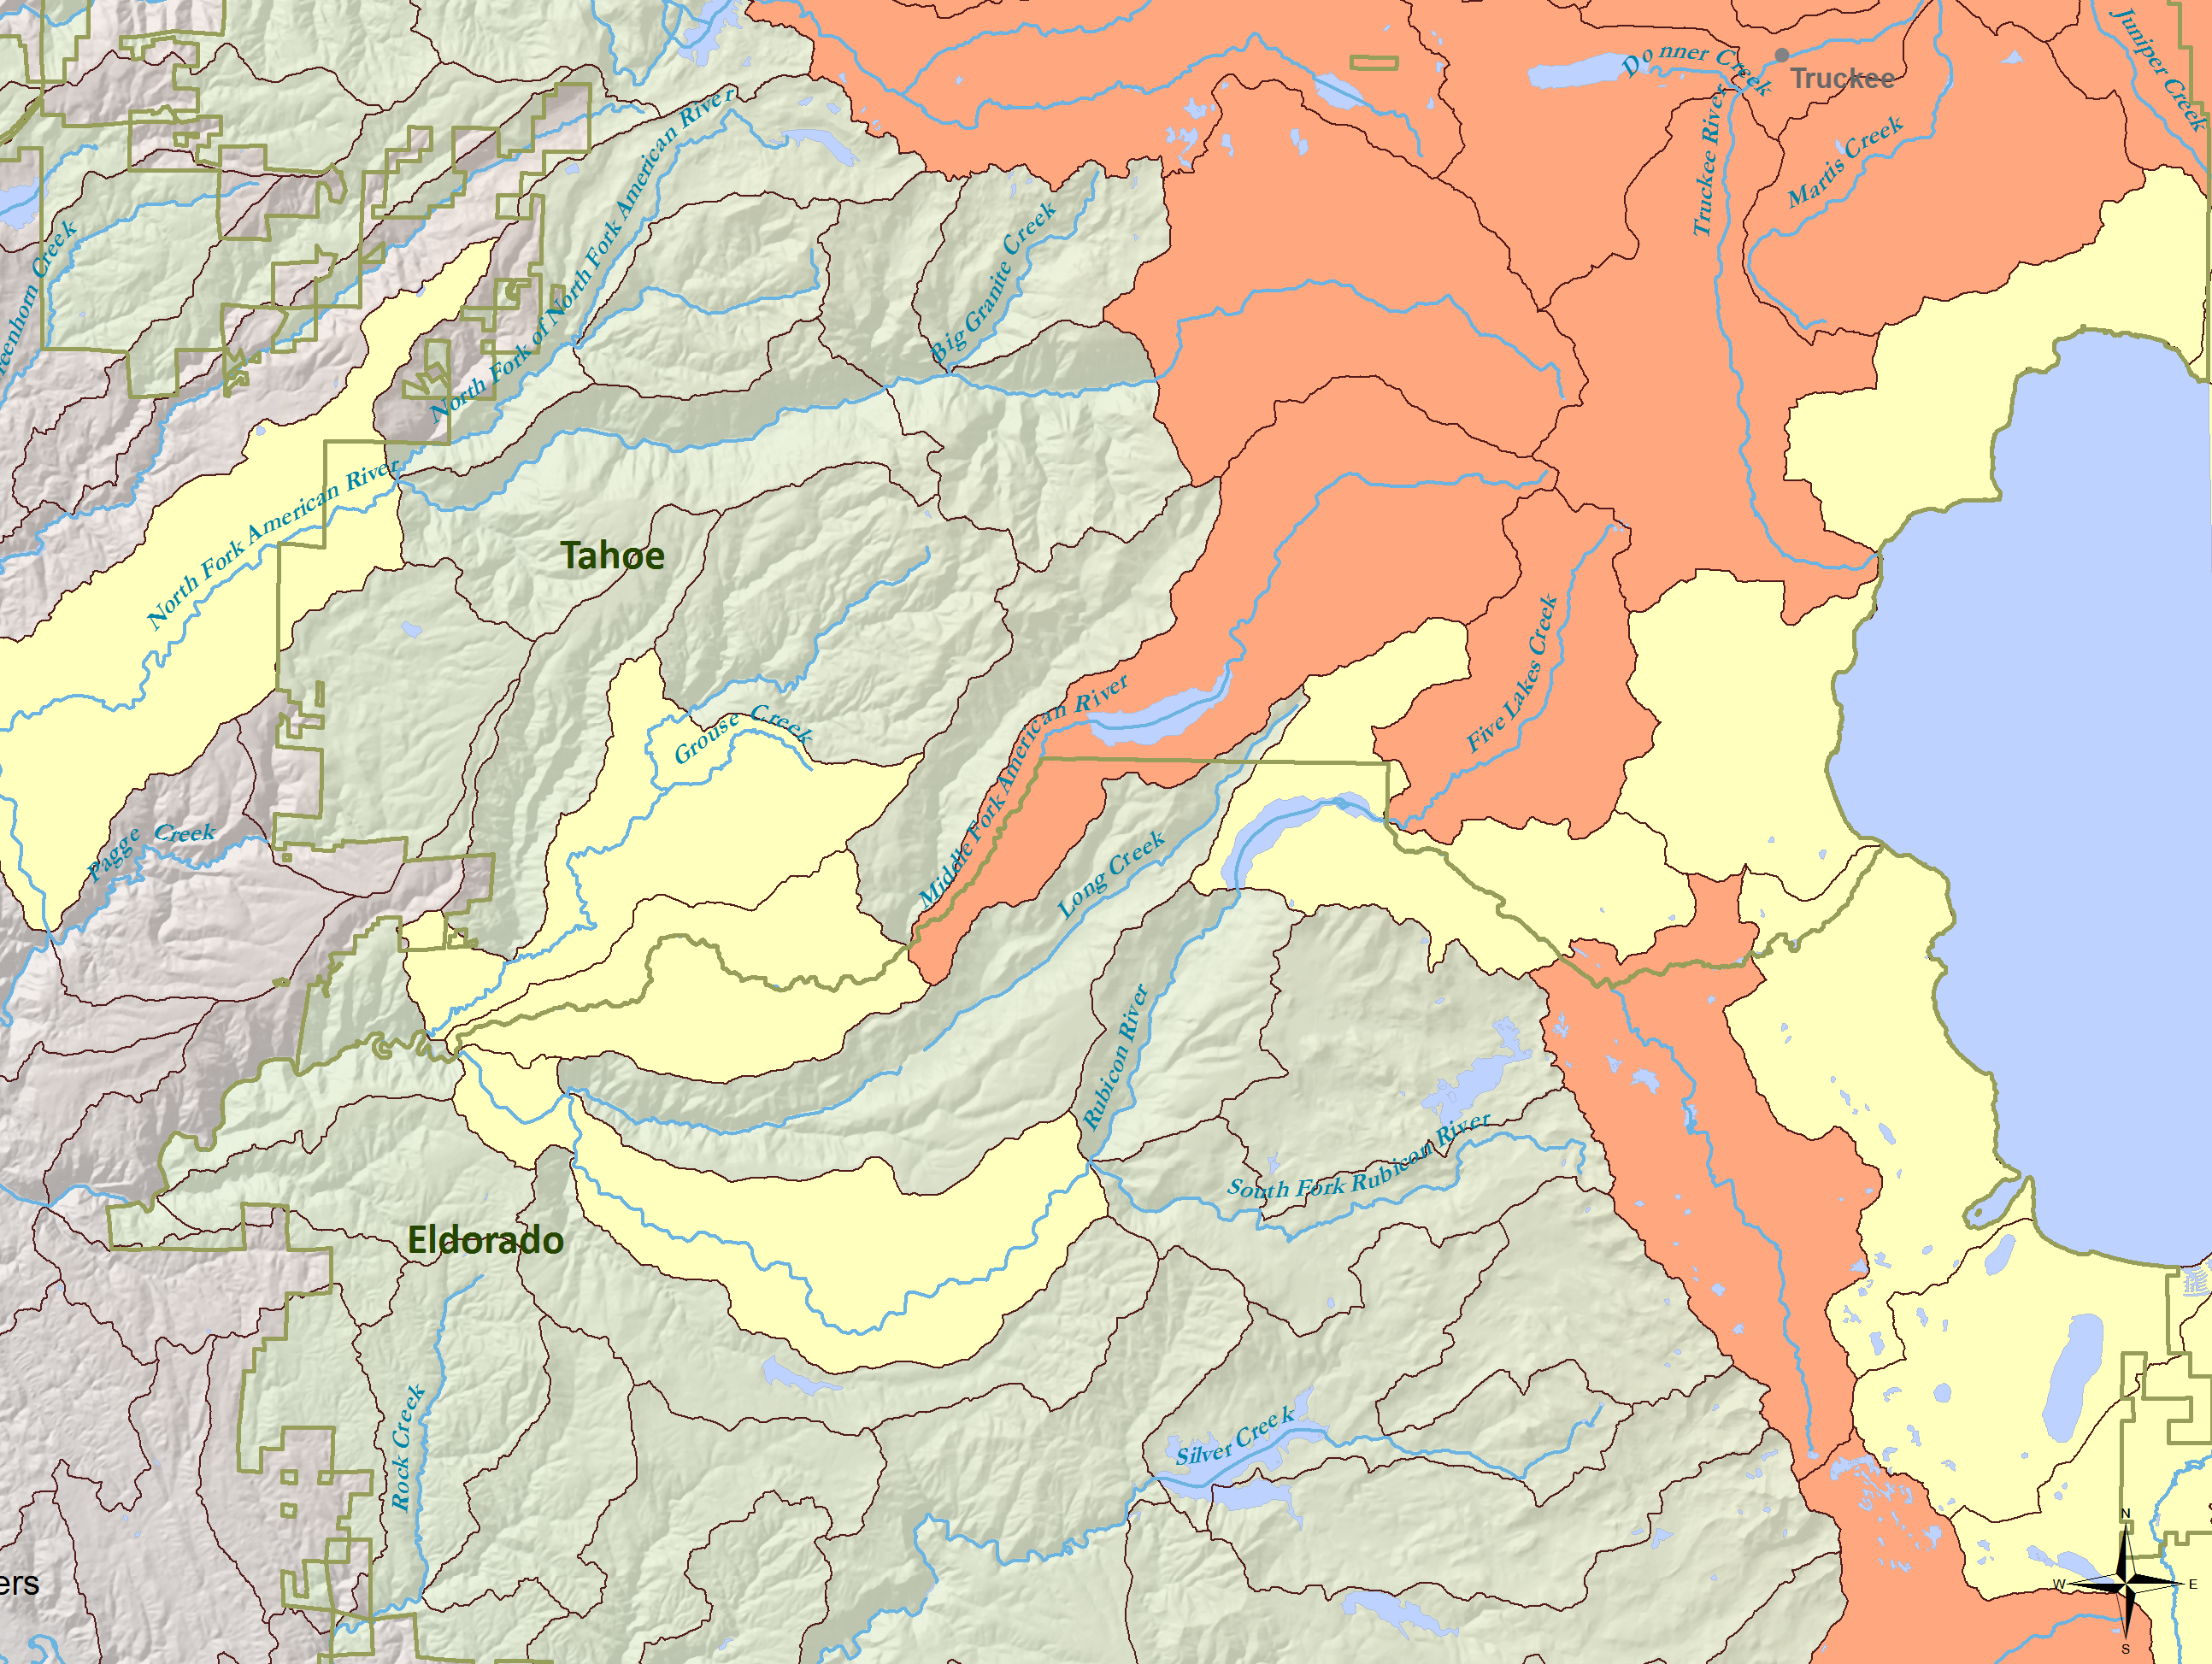
PISCES: Mapping fish species!
Now with award-winning goodness!

Slide 2
Review of PISCES
PISCES is software that standardizes, maps, and helps us analyze the distribution of fish species in California based on watershed units.
PISCES records:
a species,
in a watershed,
at a time,
with a qualifier,
attributed to a source and source data
and with appropriate metadata
Along with related information PISCES automatically generates appropriate rangemaps that layer multiple data types for all taxa with minimal configuration. Through basic plugins, PISCES generates complex maps that relate biological, climatic, and spatial variables.

Slide 3
System Design
Data Importer
Mapper
Normalizes Data, Tracks It, and Determines Relevant Attributes
Processes Data and Generates Varieties of Custom Maps
Data
Editable Map Documents (mxds)
Database
Input Filter
Data
Input Filter
Plugins
Data
Reports
Cached Distributions
Maps

Slide 4
What can we do?
Standardize data
Store metadata of our own and of PISCES’s determination
Trace data back
Generate large numbers of maps with varying data and extents very quickly.
Ask powerful questions easily and get the results as a set of maps.

Slide 5
New(!!) since last time
We are now able to add and edit data live in ArcMap – previously only importing existing data.
Won 2nd place for software integration at 2011 ESRI User Conference (field size > 2).
Delivered draft distributions of sensitive species
Refined mapping and interaction tools
All code and data under version control

Slide 6
Some PISCES stats
4600+ lines of Python code wrapped around ArcGIS, Microsoft Access, and various libraries
Refined distributions for 50+ taxa with historic, current, observed, and translocated populations.
Tracking data for 200+ taxa
300,000+ data points (266,000 active)
184+ imported datasets (and many more waiting) – incl. CNDDB, BIOS, and others

Slide 7
Modeling Species Presence
Standardizing multiyear (BCM) climatic and species data to HUC 12 units.
Eg: Road density, Jan/Jul Rainfall, Snowpack
Also using Kiernan vulnerability matrix
We can then join this data with the existing PISCES data as maps, tables, etc to inform possible future scenarios
To PISCES, modeled results are another form of presence

Slide 8
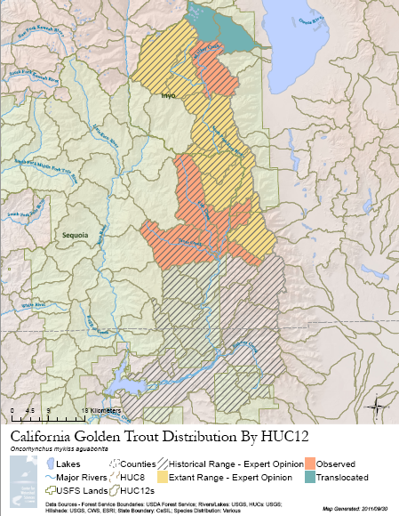
Some Maps

Slide 9
The Deep Dive
What follows is an older presentation that goes deeper into the technology behind this software. It is missing some new features, but covers the core

Slide 10
What is PISCES?
Software that standardizes, maps, and helps us analyze the distribution of fish species in California based on watershed units.
Extensible: handles multiple
data formats
map setups
“questions”
Powerful: correlated information about species and zones allows for in depth analysis via maps and reports
Approach
Notes:
Objectives
Capabilities and Methods
In most cases only the database is needed for configuration
Multiple attachment points for Callbacks
Current and Future attachments
Results
Analysis

Slide 11
What are we hoping to know?
?
Which native and threatened species will be impacted by future Forest Service management decisions and projects?
Where are all fish? Other aquatic vertebrates?
Where should conservation efforts be targeted?
What are their relationships to each other? To environmental factors? Future conditions?
Leads to…
Approach
Notes:
At its basic level, it’s a simple database. It currently does very few true calculations that aren’t just reshaping the same data into another format. We’ve overdesigned it on purpose though to be able to handle these more complex synthesis questions. “Where are all of the fish” is really just a boolean yes/no sort of program. Relationships are, naturally, much more complex, and aiding decisions requires being able to answer questions flexibly, with the right set of data feeding in and the right format coming out to help inform.

Slide 12
Parameters
{}
Mapping Unit: HUC12s – A hierarchical set of watershed boundaries. HUC12s are the most granular.
Flexible
Extent: Forest Service Lands, Statewide
Species: Native fish, other aquatic species
Abstract and Wait: Code in power where we need it, and be ready to code more where new needs arise.
Approach
Notes:
By using HUC12s, we’re inherently assuming something about the movement patterns of a particular species, so we remain limited in the current form to species which can be accurately described by a HUC12 distribution. However, if you throw another “cookie cutter,” so to speak – essentially any sort of zoning system, at it that more accurately describes another species, then we can store that too.

Slide 13
Tools and Data
ArcGIS and ArcPy: Provide interfaces to handle spatial data
MS Access: Data storage and reporting
Python: The glue that makes everything happen
Data: Mostly USFS; Moyle and Randall 1998; Moyle and Katz 2011; and assorted others.
Approach

Slide 14
Understanding Everyone’s Data
Data comes in many formats
Tabular (think Excel)
Geospatial (think GIS)
Data comes in many styles
Different data storage philosophies and systems
Need a system that can handle any data
Hybrid/cascading approach to this
Methods
Notes:
Anyone who has ever tried to manage the data for a large group knows how difficult it is to keep data in one format/style/organization structure. We’re asking for this data after the fact, so we need to have something flexible enough to understand it no matter what.
This gets technical really quickly. However, it’s not our goal to handle every possible data format in existence, but instead to be able to get as much data as possible into an importable format as quickly as possible.

Slide 15
Input Filters!
Think of them as interpreters. They take data in one form and translate it into HUCs.
Make assumptions that data will be tabular, spatial, or both
Start with the most generic import code and scale up to more specific forms from there.
Data
Input Filter
Data
Input Filter
Data
Plugins
Methods
Notes:
In some cases, we have a single species with geospatial data, sometimes multispecies with geospatial data, sometimes multi species with coordinates, and sometimes single species with coordinates. We need to be able to handle all of this.

Slide 16
Standardizing Data
Traceable – find the source dataset and in many cases, the actual observation of any piece of data
Each piece of data is assigned:
Need to do quite a bit to determine these things
An Observation Set
Certainty
Observation Type
Observer
Survey Method
Date
Flexible “Other Data”
Processing Code
A species!
Methods

Slide 17
Data Products
Saved distribution layers for each species (or other variable)
Quick use to load into another map
Editable map documents for each map
PDF and PNG format maps for each fish and forest
Editable Map Documents (mxds)
Database
Plugins
Cached Distributions
Maps
Methods

Slide 18
Mapping
It’s about asking the right question and then selecting the right options
The basic question:
select distinct Zone_ID from Observations where Species_ID = ?
Where Presence_Type = [1,2,3,4,5], etc
POWER:
Templates
Iterators and groups
Callbacks (followup)
Methods

Slide 19
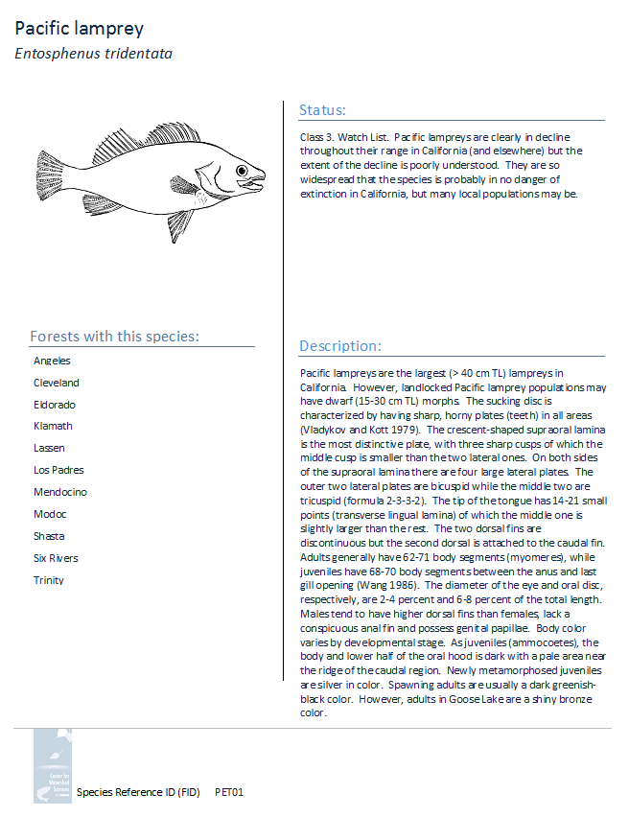
Reporting
Qualitative information about each species provided in conjunction with results and maps from PISCES.
Database
Uses Access’ native reporting capabilities
Work in progress
Reports
Methods

Slide 20
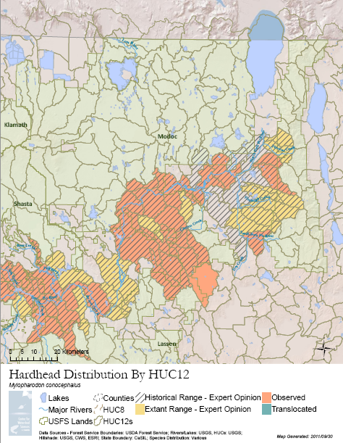
Results
Currently: Range maps for 108 taxa in multiple formats and broken out by forest
Multiple species richness maps
Basic reports of species presence on a per-forest basis
Results and Analysis

Slide 21
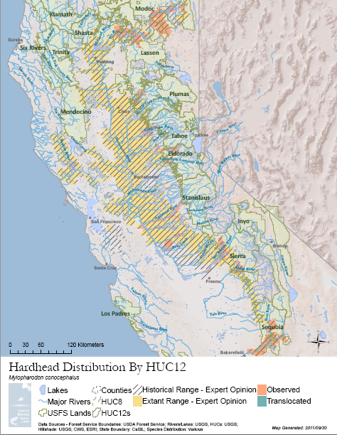

Slide 22
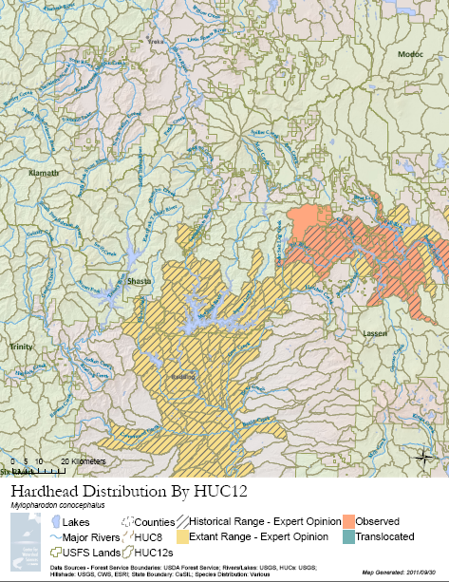

Slide 23
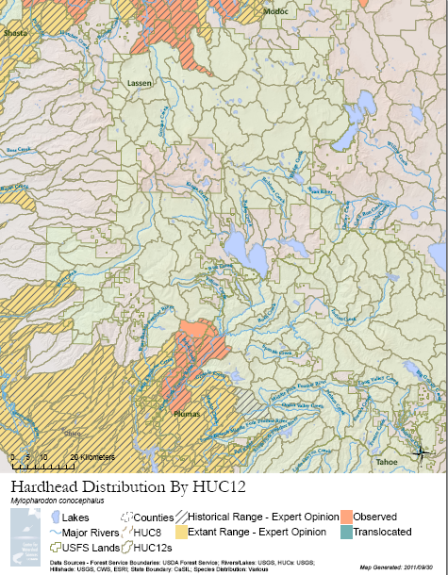

Slide 24
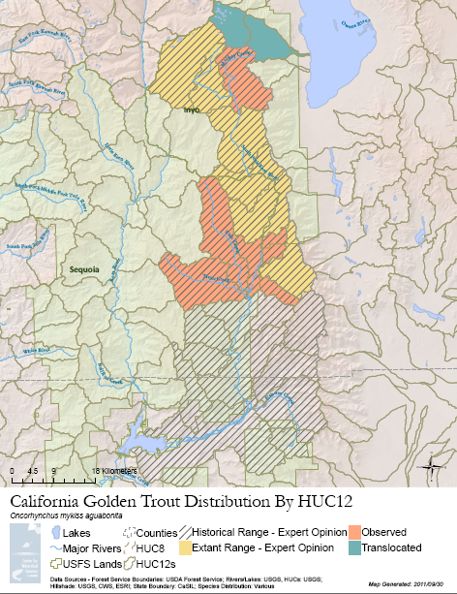

Slide 25
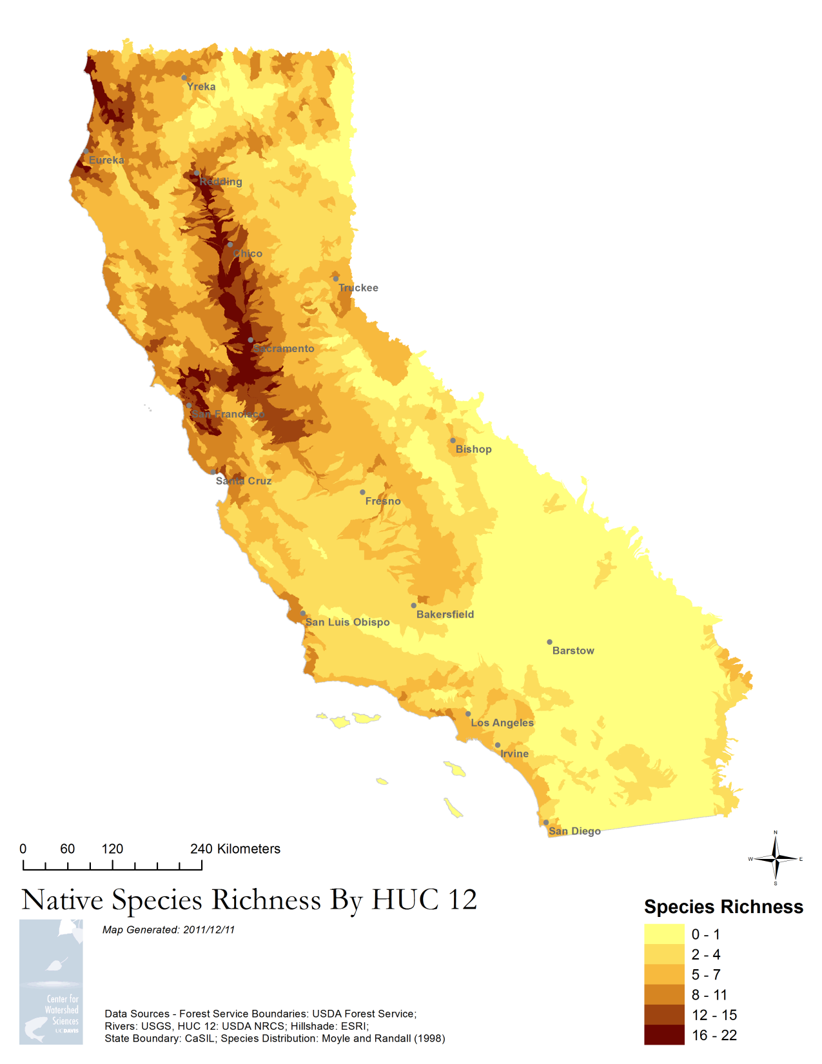
Analysis
Richness maps are the first step
Tons of potential here for HUC level analysis
Predictions
Correlations
Impact Assessment
Uniqueness/Spatial Assessments
Prioritization
Results and Analysis

